Slide 1
Smart Farmer – IOT Enabled Smart Farming Application
Team Members:
VARUN PRASAD. K
RAMAKUMAR. B
SOMANATH. S
LAKSHMINARAYANAN. VR
PAVAN KUMAR. VV
Mentor Name:
MR. RADHAKRISHNAN. K
Evaluator Name:
MR. GNANA ARUN JOHNSON. J

Slide 2
ABSTRACT
The smart farming is considered as an alternate method to overcome the food crisis which is generated due to high population, water scarcity, climate change.
The advancement of IOT(Internet Of Things) has introduced smart solution to automate the smart farming parameters such as plant monitoring, irrigation control, temperature and humidity.
In the proposed project work, the components introduced are sprinkler, camera, temperature sensor, humidity sensor, PIR sensor are implemented and other components are water pump, lock, monitor, pipe and water tanks.
The rain water is collected and stored in the surface tank.
There are two tanks presented in which one is placed inside the soil and another is placed on the upper surface.
When the plant needs water which is detected by temperature & humidity sensor as well as camera. The water is sprinkled by sprinkler.
When the present tank is empty, the water in the underground will pump the water by the water pump and passes to the surface tank.
The water pump is also used to sprinkle the water in sprinkler.
The camera is used to detect the plants growth, nutrients etc.
The farmer is needed to monitor the plants without spending more time, energy and labour power. In future the atmospheric water generators are used to produce water

Slide 3
OBJECTIVES
To design and develop a distributed system based on sensors to analyse / measure the temperature, the nutrients present in the soil, intervention of animal etc.
To implement IOT(Internet Of Things) to optimize the water consumption thereby consequently preserving local environment.
To minimize the work load, money and energy of the farmers.
Our aim is to cultivate rare crops which are presented in olden days.
In olden days the food is considered medicine but now-a-days the medicines are food for a lot of people. So the project is to grow and cultivate the olden days crops which are good for health.
With the help of our project the people will take healthy olden foods and survive for long duration.
The water present in ground becomes scarcity. So our aim is to use the rain water for present and future.

Slide 4
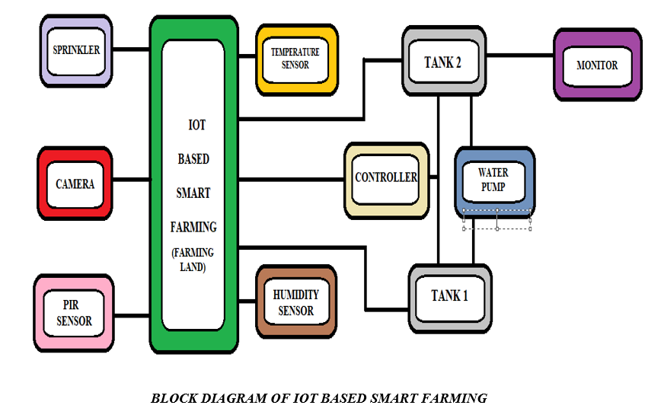
BLOCK DIAGRM

Slide 5
WORK PROGRESS
Completed task
Literature survey, Empathy map canvas, Problem statement are completed .
Idealation and Proposed solution fit is completed.
Solution fit and architecture is completed.
Cloud platform is created.
We created a outline of the project with a block diagram and execution part is on progress.
Both hardware and software implementation is on progress.
Canvas map is in on progressing.
Node RED is to be created.
IBM Watson is to be created.

Slide 6
ASSIGNMENTS ASSIGNED
ASSIGNMENT 1:
Build a smart home in tinkercart, Use at least two sensors, LED, buzzer in a circuit and simulate in a single
code. – WORK FINISHED & SUBMITTED.
ASSIGNMENT 2:
Build a python code. Assume u get temperature and humidity values (generated with random function to a variable)
and write a condition to continuously detect alarm in case of high temperature. – WORK FINISHED & SUBMITTED.
ASSIGNMENT 3:
Write python code for blinking LED and Traffic light for Raspberry Pi. Only python code is enough, no need to execute in raspberry pi. – WORK FINISHED AND SUBMITTED
ASSIGNMENT 4:
Built a ultra sonic sensor setup in wowki- WORK FINISHED AND SUBMITTED

Slide 7
INTERACTION DONE WITH COMPANY MENTORS
No such interaction is made with the company mentors till now.
We had chat in Rocket Hub and ask few doubts.
Till now we finished our assignments and tasks allotted.

Slide 8
PROBLEM STATEMENTS AND DEFINITION
Agriculture in India is largely depends on various climatic season. As a result, production of food-grains fluctuates year after year. A year of abundant output of cereals is often followed by a year of acute shortage , so our project aim doesn’t depend on monsoon. If there is shortage of water, the rain water which is stored in large tanks can be effectively used, otherwise if we need sunlight we have a heater it will give the required temperature for the plants to grow.
Water plays a major role in smart farming, due to the scarcity of water the crops are getting died and it affects the farmers. So our project is to determine the water level in soil and whenever the soil needs the water the water is sprayed. The water level in the tank will be monitored. There are various tanks to collect the rain and used it for future use.
Farmers in India and abroad face serious threats from pests, natural calamities, thefts, damages by animals and other types of crop losses, resulting in lower yields. So our project can aim to avoid animal invading into the farm . our project will detect any kind of motion and give a warning signal to the farmer And the farmer can prevent from the damage made by the crops.

Slide 9
CONCLUSIONS
This project apply combination of techniques to implement a solution to measures the the soil fertility, plants growth, humidity etc.
This system should be required necessary in the agriculture. The system measures the animaLs invading problems, water scarcity, manure usage, collection of rain water in large number of tanks.
This system works under smart technology, so the cost, time, man power can be reduced effectively

Slide 10
FUTURE SCOPE
In future due to more demand of good and more farming in less time, for betterment of the crops and reducing the usage of extravagant resources like electricity and water IOT can be implemented in most of the places. We can create few more models of the same project, so that the farmer can have information of a entire. We can update the this project by using solar power mechanism. So that the power supply from electric poles can be replaced with solar panels. It reduces the power line cost. It will be a one time investment. We can add solar fencing technology to this project. We can add camera feature so that the farmer can monitor his field in real time. This helps in avoiding thefts.

Slide 11
REFERENCES
1) Bseiso, B. Abele, S. Ferguson, P. Lusch, and K. Mehta (2015), ‘A decision support tool for greenhouse farmers in low-resource settings’, in Global Humanitarian Technology Conference (GHTC), 2015 IEEE, , pp. 292–297.
2) Dong Xuankai (2019),‘Research on Intelligent Agricultural Irrigation System’, Xi'an: Xi'an Polytechnic University.
3) D. S. Kim, T. H. Shin, and J. S. Park (2007), ‘A security framework in rfifid multi- domain system’, in Availability, Reliability and Security, 2007. ARES 2007. The Second International Conference on, , pp. 1227–1234.
4) K. A. Czyzyk, S. T. Bement, W. F. Dawson, and K. Mehta (2014), ‘Quantifying water savings with greenhouse farming’, in Global Humanitarian Technology Conference (GHTC), IEEE, , pp. 325–332.
5) Li Ke (2017), ‘Emotional Analysis of Chinese Comments Based on Multiple Feature Fusion and LSTM Neural Network’, Taiyuan: Taiyuan University of TechnologyLi.
6) Lin Juan, Liu Wenli (2018), ‘Research on Intelligent Agricultural Information System’, Electrotechnical Application, vol. 37, no. 24, pp. 91-93.

